Slide 1
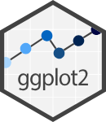

Data Visualization with
Artwork by @allison_horst

Slide 2


References
ggplot2 tidyverse page
Data visualization with ggplot2 :: Cheat Sheet
r-statistics quick reference guide
R Graphics Cookbook
R for Data Science

Slide 3

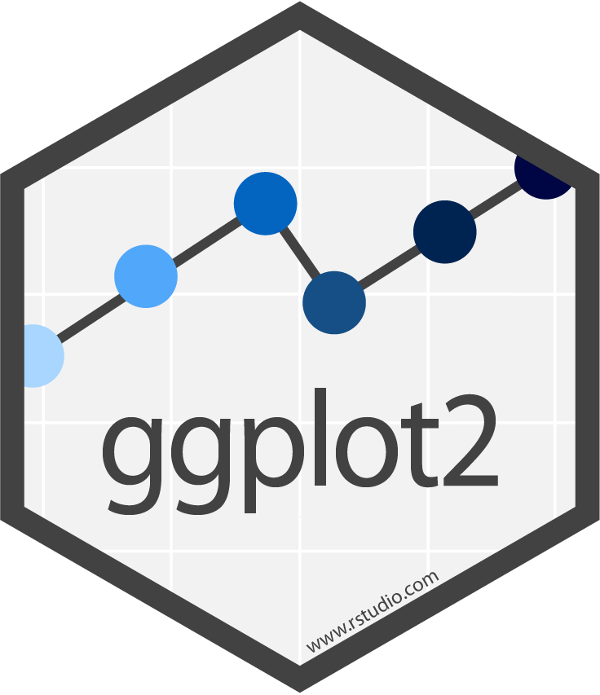









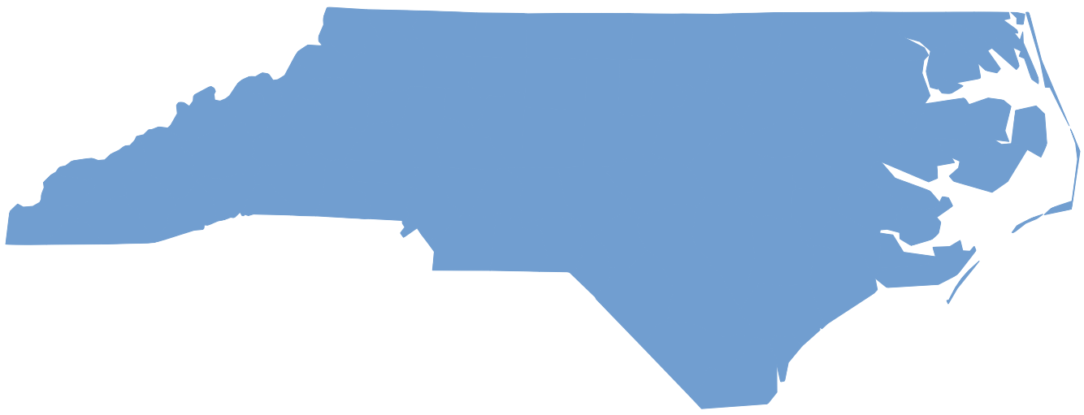


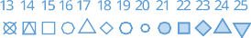

Data visualization with ggplot2 : : CHEATSHEET
Basics
ggplot2 is based on the grammar of graphics, the idea that you can build every graph from the same components: a data set, a coordinate system,
and geoms—visual marks that represent data points.
Geoms
Use a geom function to represent data points, use the geom’s aesthetic properties to represent variables. Each function returns a layer.
GRAPHICAL PRIMITIVES
a <- ggplot(economics, aes(date, unemploy))
b <- ggplot(seals, aes(x = long, y = lat))
TWO VARIABLES
both continuous
e <- ggplot(mpg, aes(cty, hwy))
continuous bivariate distribution
h <- ggplot(diamonds, aes(carat, price))
F M A
+ =
a + geom_blank() and a + expand_limits()
Ensure limits include values across all plots.
b + geom_curve(aes(yend = lat + 1,
xend = long + 1), curvature = 1) - x, xend, y, yend, alpha, angle, color, curvature, linetype, size
a + geom_path(lineend = "butt", linejoin = "round", linemitre = 1)
x, y, alpha, color, group, linetype, size
a + geom_polygon(aes(alpha = 50)) - x, y, alpha, color, fill, group, subgroup, linetype, size
b + geom_rect(aes(xmin = long, ymin = lat, xmax = long + 1, ymax = lat + 1)) - xmax, xmin, ymax, ymin, alpha, color, fill, linetype, size
a + geom_ribbon(aes(ymin = unemploy - 900, ymax = unemploy + 900)) - x, ymax, ymin, alpha, color, fill, group, linetype, size
e + geom_label(aes(label = cty), nudge_x = 1, nudge_y = 1) - x, y, label, alpha, angle, color, family, fontface, hjust, lineheight, size, vjust
e + geom_point()
x, y, alpha, color, fill, shape, size, stroke
e + geom_quantile()
x, y, alpha, color, group, linetype, size, weight
e + geom_rug(sides = “bl")
x, y, alpha, color, linetype, size
e + geom_smooth(method = lm)
x, y, alpha, color, fill, group, linetype, size, weight
e + geom_text(aes(label = cty), nudge_x = 1, nudge_y = 1) - x, y, label, alpha, angle, color, family, fontface, hjust, lineheight, size, vjust
h + geom_bin2d(binwidth = c(0.25, 500)) x, y, alpha, color, fill, linetype, size, weight
h + geom_density_2d()
x, y, alpha, color, group, linetype, size
h + geom_hex()
x, y, alpha, color, fill, size
data geom
coordinate plot system
x = F · y = A
To display values, map variables in the data to visual properties of the geom (aesthetics) like size, color, and x and y locations.
F M A
continuous function
i <- ggplot(economics, aes(date, unemploy))
+ =
i + geom_area()
x, y, alpha, color, fill, linetype, size
i + geom_line()
x, y, alpha, color, group, linetype, size
i + geom_step(direction = "hv")
x, y, alpha, color, group, linetype, size
data geom
coordinate system
plot
x = F · y = A
color = F
size = A
Complete the template below to build a graph.
ggplot (data = <DATA> ) +
LINE SEGMENTS
common aesthetics: x, y, alpha, color, linetype, size
required
one discrete, one continuous
f <- ggplot(mpg, aes(class, hwy))
visualizing error
df <- data.frame(grp = c("A", "B"), fit = 4:5, se = 1:2)
j <- ggplot(df, aes(grp, fit, ymin = fit - se, ymax = fit + se))
<GEOM_FUNCTION> (mapping = aes( <MAPPINGS> ),
b + geom_abline(aes(intercept = 0, slope = 1)) b + geom_hline(aes(yintercept = lat))
b + geom_vline(aes(xintercept = long))
stat = <STAT> , position = <POSITION> ) +
<COORDINATE_FUNCTION> +
<FACET_FUNCTION> +
<SCALE_FUNCTION> +
<THEME_FUNCTION>
Not required, sensible defaults supplied
b + geom_segment(aes(yend = lat + 1, xend = long + 1)) b + geom_spoke(aes(angle = 1:1155, radius = 1))
f + geom_col()
x, y, alpha, color, fill, group, linetype, size
f + geom_boxplot()
x, y, lower, middle, upper, ymax, ymin, alpha, color, fill, group, linetype, shape, size, weight
f + geom_dotplot(binaxis = "y", stackdir = “center") x, y, alpha, color, fill, group
f + geom_violin(scale = “area")
x, y, alpha, color, fill, group, linetype, size, weight
j + geom_crossbar(fatten = 2) - x, y, ymax, ymin, alpha, color, fill, group, linetype, size
j + geom_errorbar() - x, ymax, ymin, alpha, color, group, linetype, size, width Also geom_errorbarh().
j + geom_linerange()
x, ymin, ymax, alpha, color, group, linetype, size
j + geom_pointrange() - x, y, ymin, ymax, alpha, color, fill, group, linetype, shape, size
ggplot(data = mpg, aes(x = cty, y = hwy)) Begins a plot that you finish by adding layers to. Add one geom function per layer.
last_plot() Returns the last plot.
ggsave("plot.png", width = 5, height = 5) Saves last plot as 5’ x 5’ file named "plot.png" in working directory.
Matches file type to file extension.
ONE VARIABLE continuous
c <- ggplot(mpg, aes(hwy)); c2 <- ggplot(mpg)
c + geom_area(stat = "bin")
x, y, alpha, color, fill, linetype, size
c + geom_density(kernel = "gaussian")
x, y, alpha, color, fill, group, linetype, size, weight
c + geom_dotplot()
x, y, alpha, color, fill
c + geom_freqpoly()
x, y, alpha, color, group, linetype, size
c + geom_histogram(binwidth = 5)
x, y, alpha, color, fill, linetype, size, weight
c2 + geom_qq(aes(sample = hwy))
x, y, alpha, color, fill, linetype, size, weight
both discrete
g <- ggplot(diamonds, aes(cut, color))
maps
Draw the appropriate geometric object depending on the simple features present in the data. aes() arguments: map_id, alpha, color, fill, linetype, linewidth.
nc <- sf::st_read(system.file("shape/nc.shp", package = "sf"))
Aes
Common aesthetic values.
g + geom_count()
x, y, alpha, color, fill, shape, size, stroke
e + geom_jitter(height = 2, width = 2) x, y, alpha, color, fill, shape, size
color and fill - string ("red", "#RRGGBB")
linetype - integer or string (0 = "blank", 1 = "solid",
2 = "dashed", 3 = "dotted", 4 = "dotdash", 5 = "longdash",
6 = "twodash")
size - integer (in mm for size of points and text)
linewidth - integer (in mm for widths of lines)
shape - integer/shape name or a single character ("a")
ggplot(nc) +
geom_sf(aes(fill = AREA))
THREE VARIABLES
seals$z <- with(seals, sqrt(delta_long^2 + delta_lat^2)); l <- ggplot(seals, aes(long, lat))
discrete
d <- ggplot(mpg, aes(fl))
l + geom_contour(aes(z = z))
x, y, z, alpha, color, group, linetype, size, weight
l + geom_raster(aes(fill = z), hjust = 0.5, vjust = 0.5, interpolate = FALSE)
x, y, alpha, fill
l + geom_tile(aes(fill = z))
x, y, alpha, color, fill, linetype, size, width
d + geom_bar()
x, alpha, color, fill, linetype, size, weight
l + geom_contour_filled(aes(fill = z))
x, y, alpha, color, fill, group, linetype, size, subgroup
CC BY SA Posit Software, PBC • info@posit.co • posit.co • Learn more at ggplot2.tidyverse.org • HTML cheatsheets at pos.it/cheatsheets • ggplot2 3.5.1 • Updated: 2024-05

Slide 4




Stats An alternative way to build a layer.
Scales Override defaults with scales package.
Scales map data values to the visual values of an aesthetic. To change a mapping, add a new scale.
n <- d + geom_bar(aes(fill = fl))
Coordinate Systems
Faceting
Facets divide a plot into subplots based on the values of one or more discrete variables.
t <- ggplot(mpg, aes(cty, hwy)) + geom_point()
t + facet_grid(. ~ fl)
Facet into columns based on fl.
A stat builds new variables to plot (e.g., count, prop).
fl cty cyl
r <- d + geom_bar()
x count
+ =
r + coord_cartesian(xlim = c(0, 5)) - xlim, ylim The default cartesian coordinate system.
data stat geom coordinate plot
aesthetic prepackaged scale-specific scale_ to adjust scale to use arguments
r + coord_fixed(ratio = 1/2)
ratio, xlim, ylim - Cartesian coordinates with fixed aspect ratio between x and y units.
r + coord_flip()
Flip cartesian coordinates by switching x and y aesthetic mappings.
r + coord_polar(theta = "x", direction=1) theta, start, direction - Polar coordinates.
x = x ·
system
n + scale_fill_manual(
values = c("skyblue", "royalblue", "blue", "navy"), limits = c("d", "e", "p", "r"), breaks =c("d", "e", "p", “r"), name = "fuel", labels = c("D", "E", "P", "R"))
y = count
Visualize a stat by changing the default stat of a geom function, geom_bar(stat="count") or by using a stat function, stat_count(geom="bar"), which calls a default geom to make a layer (equivalent to a geom function).
Use after_stat(name) syntax to map the stat variable name to an aesthetic.
geom to use stat function geommappings
t + facet_grid(year ~ .)
Facet into rows based on year.
t + facet_grid(year ~ fl)
Facet into both rows and columns.
t + facet_wrap(~ fl)
Wrap facets into a rectangular layout.
range of values
title to use in
labels to use breaks to use in
to include in
legend/axis
in legend/axis legend/axis
GENERAL PURPOSE SCALES
Use with most aesthetics
scale_*_continuous() - Map cont’ values to visual ones. scale_*_discrete() - Map discrete values to visual ones. scale_*_binned() - Map continuous values to discrete bins. scale_*_identity() - Use data values as visual ones.
scale_*_manual(values = c()) - Map discrete values to manually chosen visual ones.
scale_*_date(date_labels = "%m/%d"),
date_breaks = "2 weeks") - Treat data values as dates.
scale_*_datetime() - Treat data values as date times. Same as scale_*_date(). See ?strptime for label formats.
X & Y LOCATION SCALES
Use with x or y aesthetics (x shown here)
scale_x_log10() - Plot x on log10 scale. scale_x_reverse() - Reverse the direction of the x axis. scale_x_sqrt() - Plot x on square root scale.
COLOR AND FILL SCALES (DISCRETE)
n + scale_fill_brewer(palette = "Blues") For palette choices: RColorBrewer::display.brewer.all()
n + scale_fill_grey(start = 0.2, end = 0.8, na.value = "red")
COLOR AND FILL SCALES (CONTINUOUS)
o <- c + geom_dotplot(aes(fill = x))
o + scale_fill_distiller(palette = “Blues”)
o + scale_fill_gradient(low="red", high=“yellow")
o + scale_fill_gradient2(low = "red", high = “blue”, mid = "white", midpoint = 25)
o + scale_fill_gradientn(colors = topo.colors(6)) Also: rainbow(), heat.colors(), terrain.colors(), cm.colors(), RColorBrewer::brewer.pal()
SHAPE AND SIZE SCALES
p <- e + geom_point(aes(shape = fl, size = cyl))
p + scale_shape() + scale_size()
p + scale_shape_manual(values = c(3:7))
p + scale_radius(range = c(1,6))
p + scale_size_area(max_size = 6)
i + stat_density_2d(aes(fill = after_stat(level)),
r + coord_trans(y = “sqrt") - x, y, xlim, ylim Transformed cartesian coordinates. Set xtrans and ytrans to the name of a window function.
π + coord_sf() - xlim, ylim, crs. Ensures all layers use a common Coordinate Reference System.
geom = "polygon")
variable created by stat
Set scales to let axis limits vary across facets.
t + facet_grid(drv ~ fl, scales = "free")
x and y axis limits adjust to individual facets: "free_x" - x axis limits adjust "free_y" - y axis limits adjust
Set labeller to adjust facet label:
t + facet_grid(. ~ fl, labeller = label_both)
c + stat_bin(binwidth = 1, boundary = 10) x, y | count, ncount, density, ndensity
c + stat_count(width = 1) x, y | count, prop
c + stat_density(adjust = 1, kernel = "gaussian") x, y | count, density, scaled
e + stat_bin_2d(bins = 30, drop = T) x, y, fill | count, density
e + stat_bin_hex(bins = 30) x, y, fill | count, density
e + stat_density_2d(contour = TRUE, n = 100) x, y, color, size | level
e + stat_ellipse(level = 0.95, segments = 51, type = "t")
l + stat_contour(aes(z = z)) x, y, z, order | level
l + stat_summary_hex(aes(z = z), bins = 30, fun = max) x, y, z, fill | value
l + stat_summary_2d(aes(z = z), bins = 30, fun = mean) x, y, z, fill | value
f + stat_boxplot(coef = 1.5)
x, y | lower, middle, upper, width , ymin, ymax
f + stat_ydensity(kernel = "gaussian", scale = "area") x, y | density, scaled, count, n, violinwidth, width
e + stat_ecdf(n = 40) x, y | x, y
e + stat_quantile(quantiles = c(0.1, 0.9),
formula = y ~ log(x), method = "rq") x, y | quantile
e + stat_smooth(method = "lm", formula = y ~ x, se = T, level = 0.95) x, y | se, x, y, ymin, ymax
ggplot() + xlim(-5, 5) + stat_function(fun = dnorm, n = 20, geom = “point”) x | x, y
ggplot() + stat_qq(aes(sample = 1:100)) x, y, sample | sample, theoretical
e + stat_sum() x, y, size | n, prop
e + stat_summary(fun.data = "mean_cl_boot")
h + stat_summary_bin(fun = "mean", geom = "bar") e + stat_identity()
e + stat_unique()
Position Adjustments
Position adjustments determine how to arrange geoms that would otherwise occupy the same space.
s <- ggplot(mpg, aes(fl, fill = drv))
fl: c | fl: d | fl: e | fl: p | fl: r
t + facet_grid(fl ~ ., labeller = label_bquote(alpha ^ .(fl)))
s + geom_bar(position = "dodge")
Arrange elements side by side.
s + geom_bar(position = "fill") Stack elements on top of one another, normalize height.
e + geom_point(position = "jitter") Add random noise to X and Y position of each element to avoid overplotting.
e + geom_label(position = "nudge")
Nudge labels away from points.
s + geom_bar(position = "stack")
Stack elements on top of one another.
↵c ↵d ↵e
↵p ↵r
Labels and Legends
Use labs() to label the elements of your plot.
t + labs(x = "New x axis label", y = "New y axis label",
title ="Add a title above the plot", subtitle = "Add a subtitle below title", caption = "Add a caption below plot", alt = "Add alt text to the plot",
<<AaEeSs>> = "New <<aAeEsS>> legend title")
t + annotate(geom = "text", x = 8, y = 9, label = “A") Places a geom with manually selected aesthetics.
p + guides(x = guide_axis(n.dodge = 2)) Avoid crowded or overlapping labels with guide_axis(n.dodge or angle).
n + guides(fill = “none") Set legend type for each aesthetic: colorbar, legend, or none (no legend).
n + theme(legend.position = "bottom")
Place legend at "bottom", "top", "left", or “right”.
n + scale_fill_discrete(name = "Title", labels = c("A", "B", "C", "D", "E"))
Set legend title and labels with a scale function.
Zooming
A
B
Each position adjustment can be recast as a function with manual width and height arguments:
s + geom_bar(position = position_dodge(width = 1))
Themes
r + theme_bw() White background with grid lines.
r + theme_gray() Grey background (default theme).
r + theme_dark()
Dark for contrast.
r + theme_classic() r + theme_light()
r + theme_linedraw() r + theme_minimal()
Minimal theme.
r + theme_void()
Empty theme.
Without clipping (preferred):
t + coord_cartesian(xlim = c(0, 100), ylim = c(10, 20)) With clipping (removes unseen data points):
t + xlim(0, 100) + ylim(10, 20)
t + scale_x_continuous(limits = c(0, 100)) + scale_y_continuous(limits = c(0, 100))
r + theme() Customize aspects of the theme such as axis, legend, panel, and facet properties.
r + labs(title = “Title”) + theme(plot.title.position = “plot”) r + theme(panel.background = element_rect(fill = “blue”))
CC BY SA Posit Software, PBC • info@posit.co • posit.co • Learn more at ggplot2.tidyverse.org • HTML cheatsheets at pos.it/cheatsheets • ggplot2 3.5.1 • Updated: 2024-05

Slide 5
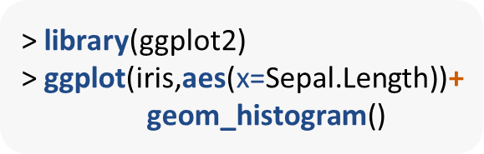
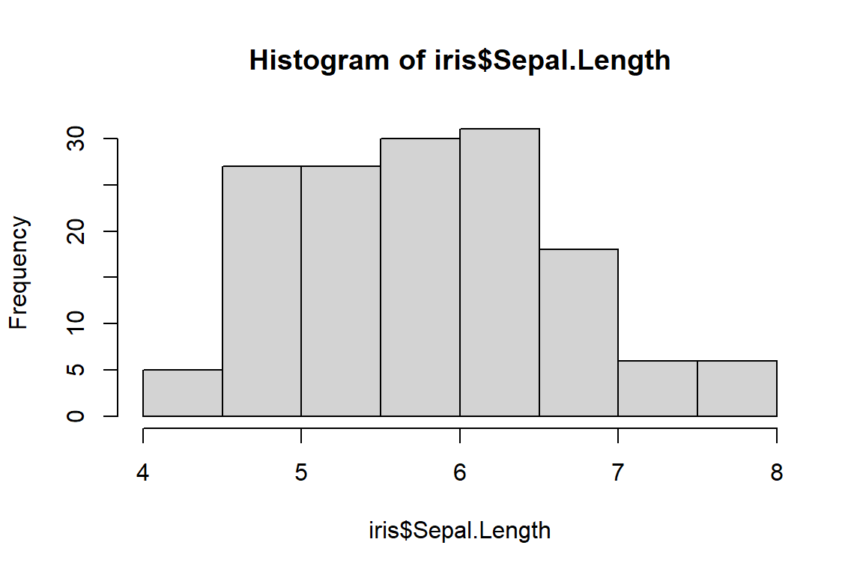
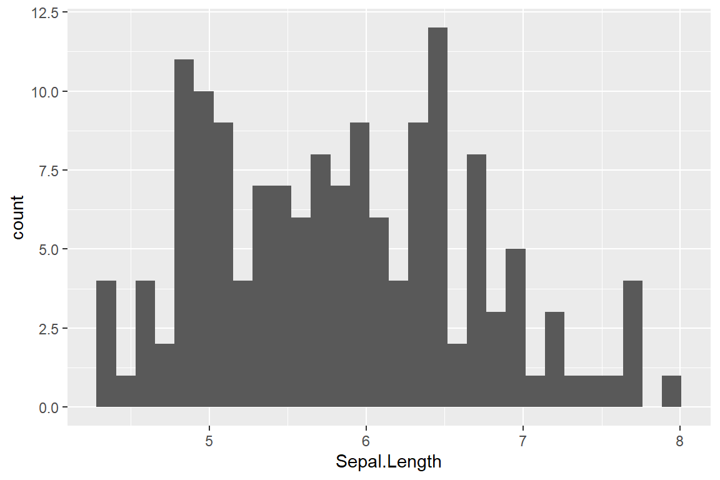
Base R vs
> hist(iris$Sepal.Length)

Slide 6
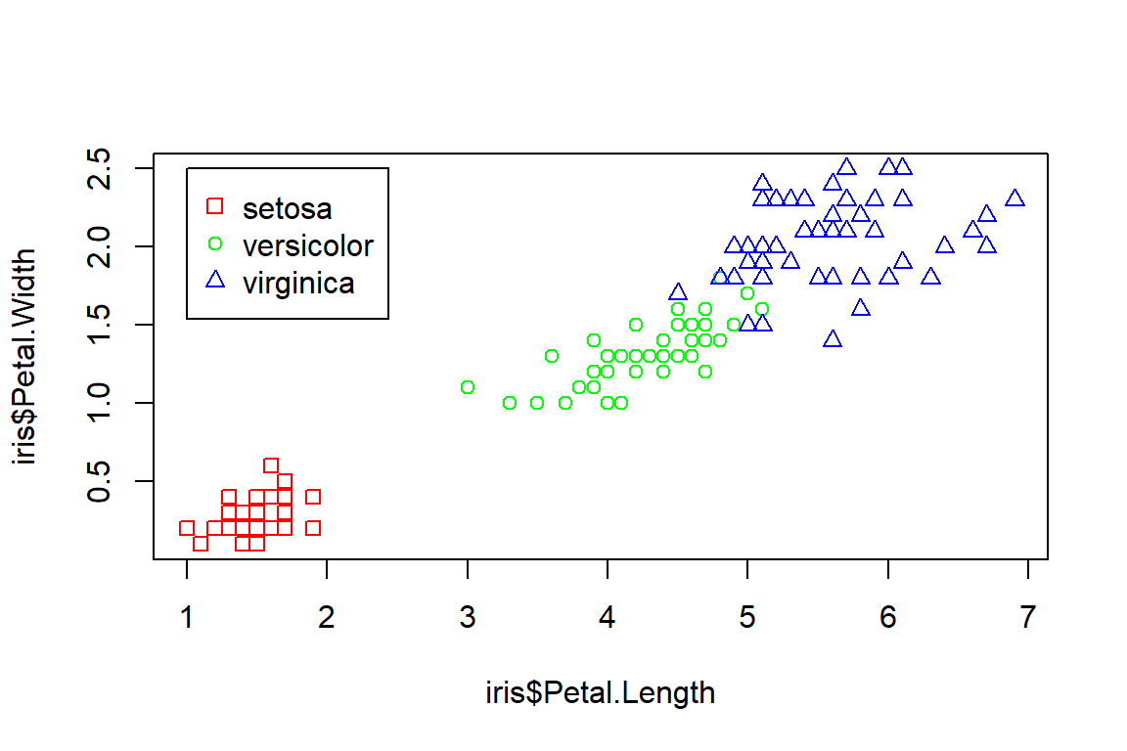
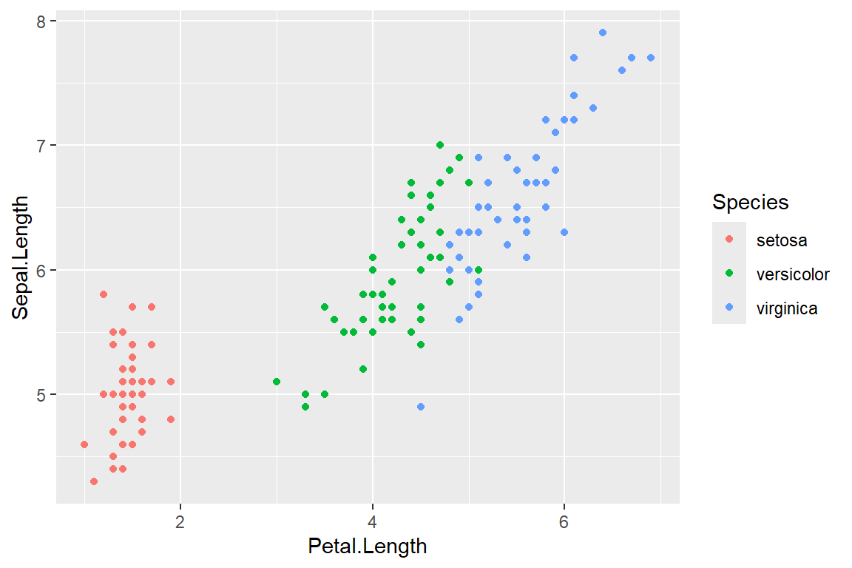
Base R vs
> plot(iris$Petal.Length,iris$Petal.Width, col=c("red","green","blue")[iris$Species], pch=c(0,1,2)[iris$Species])
> legend(x=1,y=2.5, legend=c("setosa","versicolor","virginica"), pch=c(0,1,2),col=c("red","green","blue"))
> ggplot(iris,aes(Petal.Length,Sepal.Length,color=Species))+ geom_point()

Slide 7
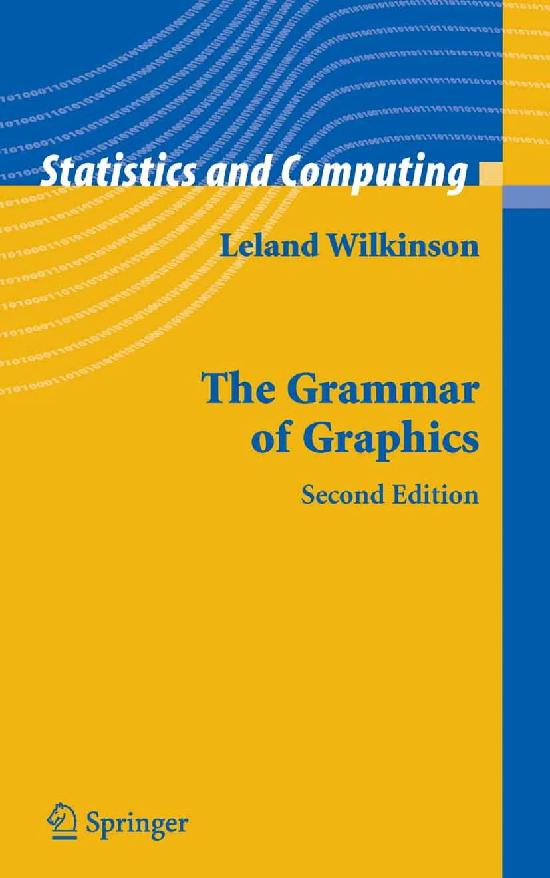
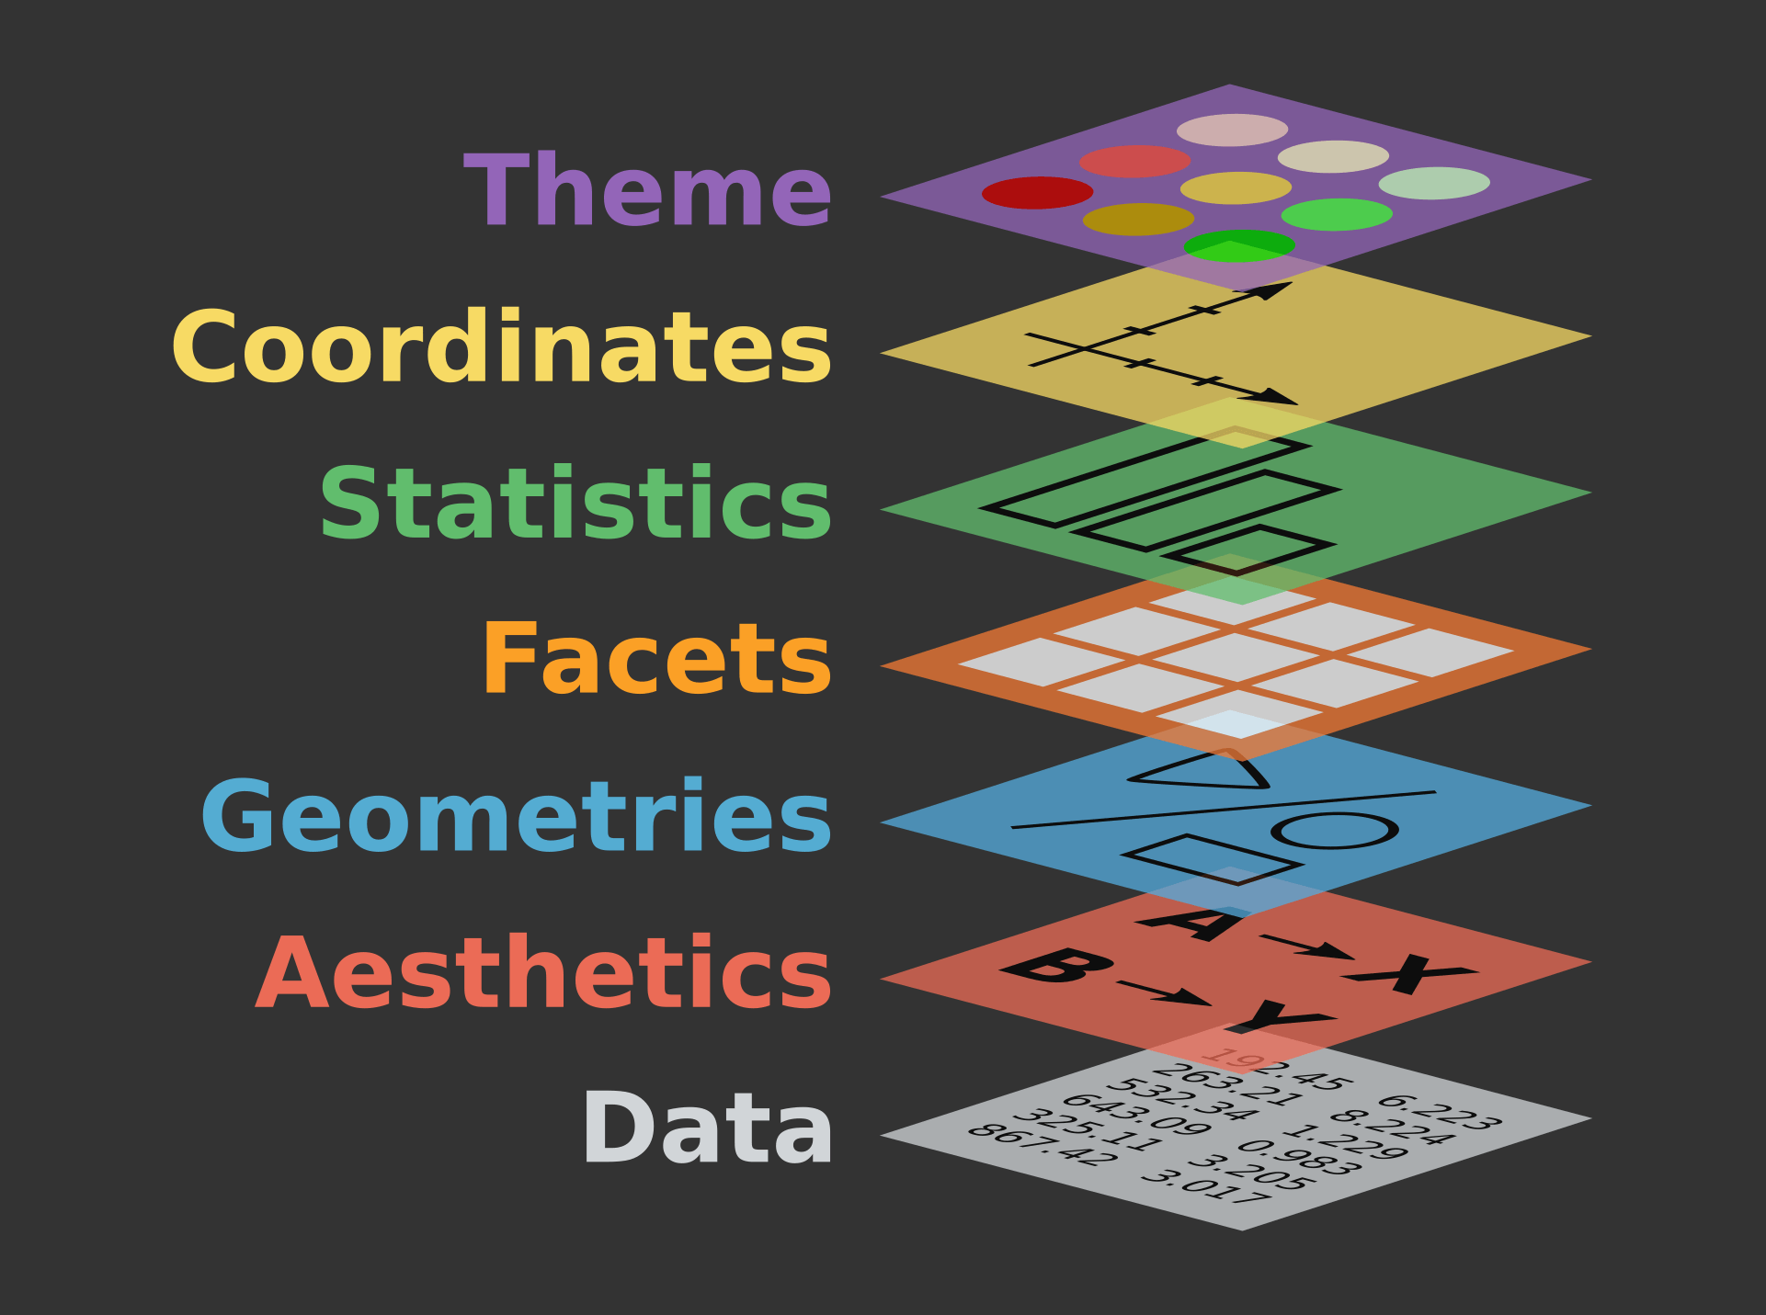
Grammar of Graphics
theme: adjusts non-data elements like fonts, grid lines, backgrounds coord: sets the coordinate system (e.g., Cartesian, Polar)
stat: statistical transformation (e.g., counts, means, regression lines) facet: splits the data into subsets
geom: type of visual marks used (points, bars, lines, etc.) aes: how data variables are mapped to visual properties (X, Y, color, size, shape) data: the dataset you’re visualizing
Image Source
The Grammar of Graphics | SpringerLink
Notes:
ggplot2 is built on the Grammar of Graphics — a philosophy that views visualizations as layered, structured compositions of data and visual elements. Instead of thinking of plots as monolithic images, the grammar breaks them down into flexible building blocks.
At its core, the grammar says a plot is constructed from:
Data: What you're visualizing
Aesthetics: How data variables map to visual properties (e.g., x, y, color)
Geoms: The shapes used to display data (e.g., points, lines, bars)
Stats: Optional data transformations (e.g., smoothing, counts)
Coordinates: The system that places elements (e.g., Cartesian, polar)
Facets: Create small multiples for subgroups
Themes: Control the appearance of non-data elements (fonts, background colors, labels etc)
Together, these layers are combined with a consistent syntax, allowing users to build plots piece by piece like constructing a sentence — making it both powerful and expressive.

Slide 8
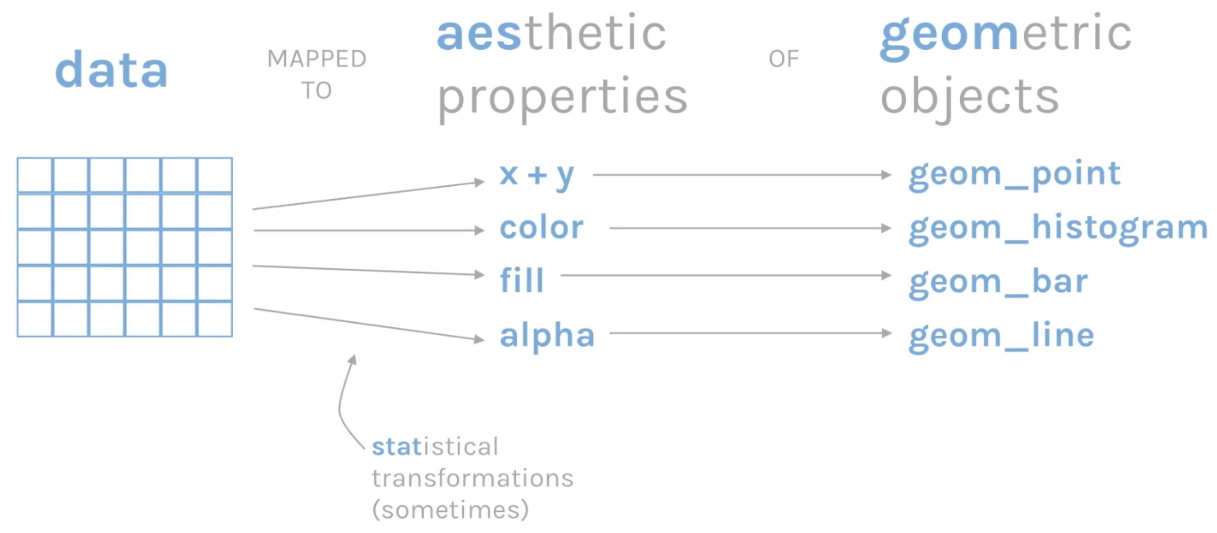
XDASI: Exploratory Data Analysis and Statistical Inference
Notes:
Every ggplot is composed of *Three Essential Layers*
Data is the foundation
Aesthetics defines how we map our variables.
The geometric object, or the type of plot we want to display the data

Slide 9
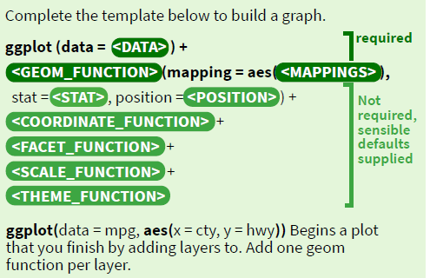
Basics
ggplot2 is based on the grammar of graphics, the idea that you can build every graph from the same components: a data set, a coordinate system,
and geoms—visual marks that represent data points.
F M A
+ =
data geom
coordinate plot system
x = F · y = A
To display values, map variables in the data to visual properties of the geom (aesthetics) like size, color, and x and y locations.
F M A
+ =
data geom
coordinate system
plot
x = F · y = A
color = F
size = A
Complete the template below to build a graph.
ggplot (data = <DATA> ) +
required
<GEOM_FUNCTION> (mapping = aes( <MAPPINGS> ),
stat = <STAT> , position = <POSITION> ) +
<COORDINATE_FUNCTION> +
<FACET_FUNCTION> +
<SCALE_FUNCTION> +
<THEME_FUNCTION>
Not required, sensible defaults supplied
ggplot(data = mpg, aes(x = cty, y = hwy)) Begins a plot that you finish by adding layers to. Add one geom function per layer.
last_plot() Returns the last plot.
ggsave("plot.png", width = 5, height = 5) Saves last plot as 5’ x 5’ file named "plot.png" in working directory.
Matches file type to file extension.

Slide 10
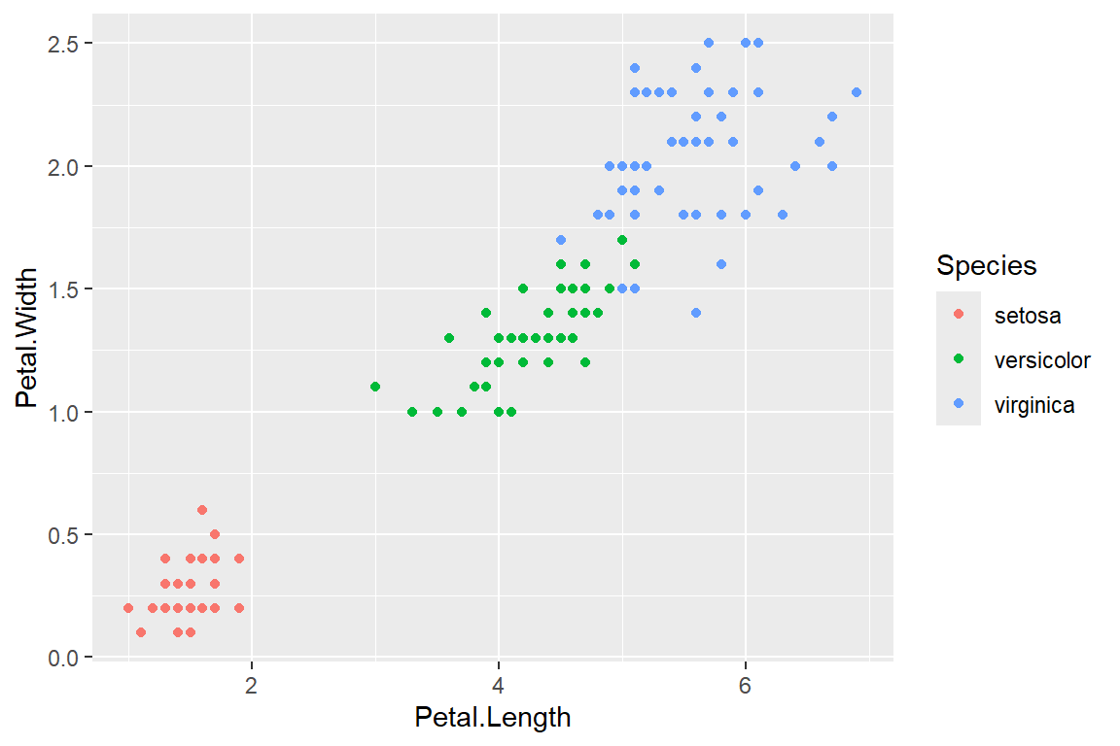
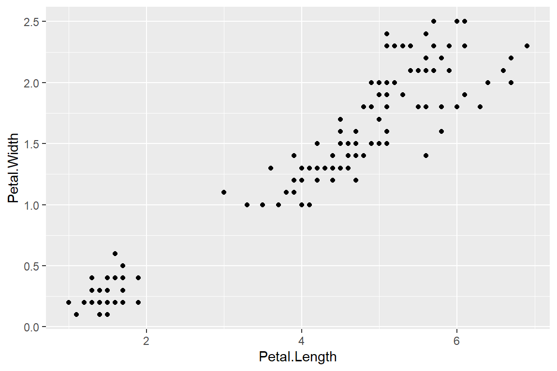
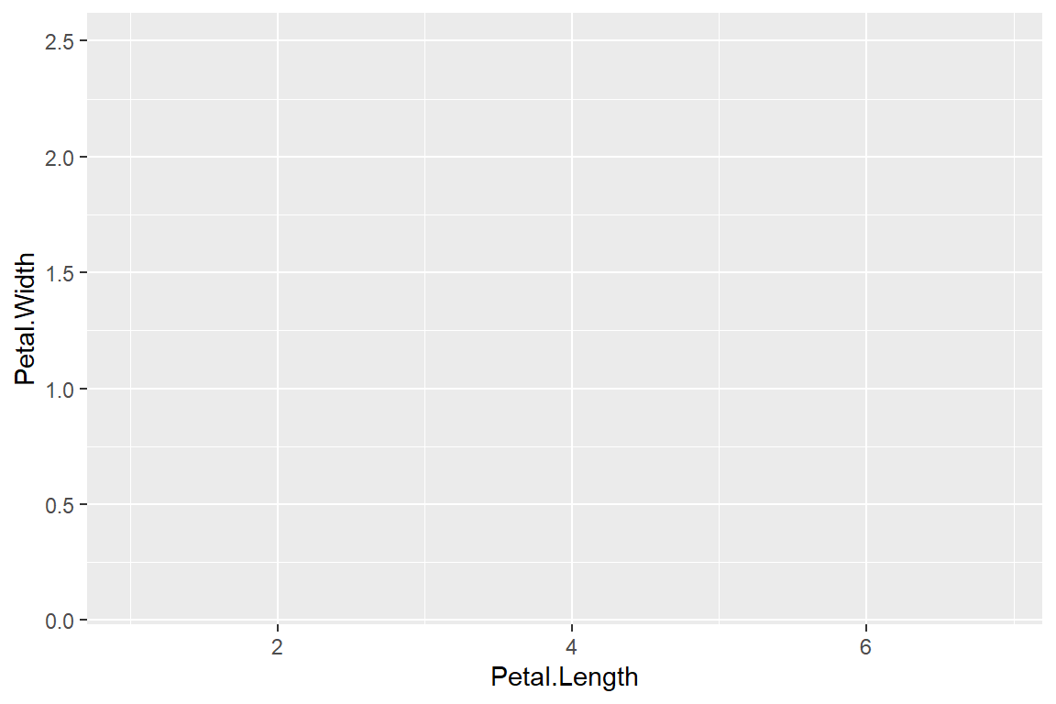
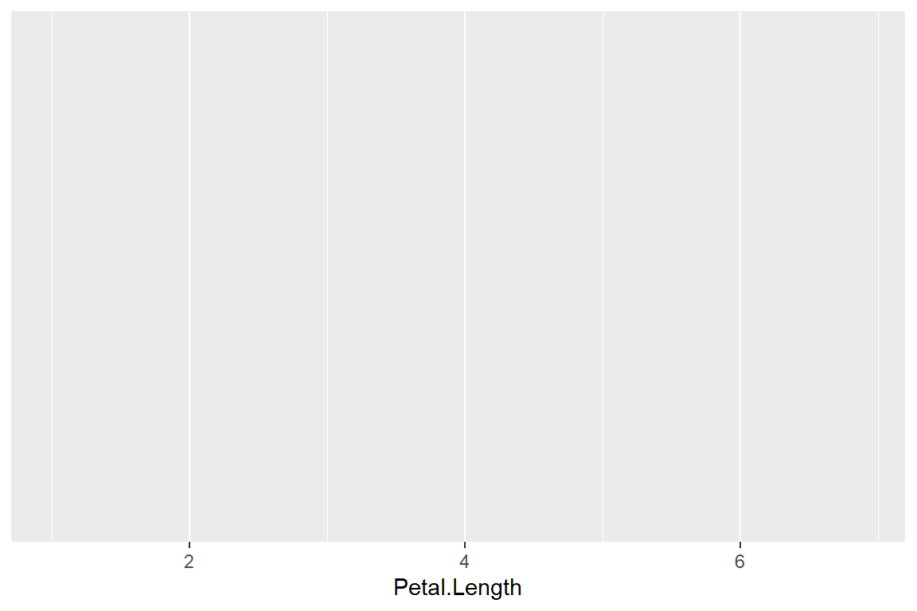

Building a plot
>ggplot(data = iris, mapping = aes(x = Petal.Length, y = Petal.Width, color = Species)) + geom_point()
>ggplot(data = iris, mapping = aes(x = Petal.Length, y = Petal.Width)) + geom_point()
> ggplot(data = iris, mapping = aes(x = Petal.Length, y = Petal.Width))
> ggplot(data = iris, mapping = aes(x = Petal.Length))
> ggplot(data = iris)
Notes:
First we start with our data. Here we are using the classic Iris dataset. Next we map our first variable Petal.Length to the Xaxis
Then Petal.Width to the Y axis
Last our geometric object. Here we used geom_point() which produces an X-Y scatterplot
Additionally, we can add another geometric mapping where we map species to color.

Slide 11

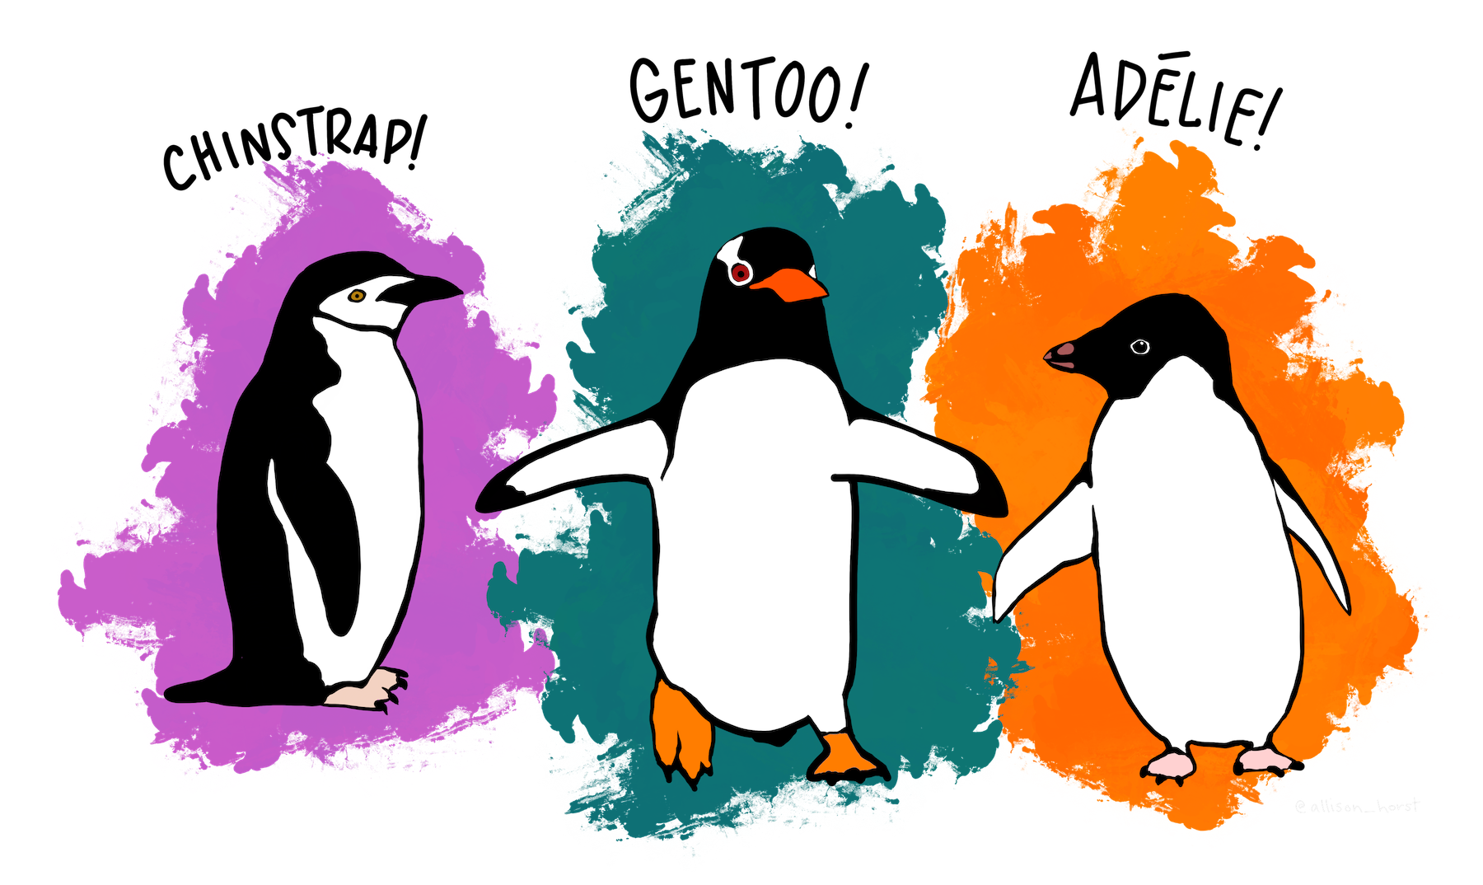
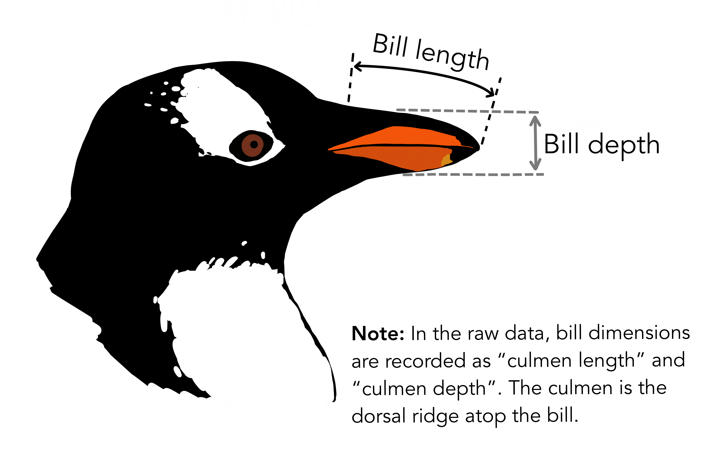
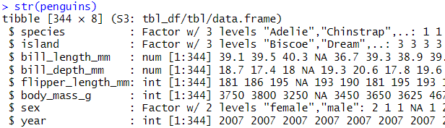
Artwork by @allison_horst
Notes:
Palmer penguins as a new alternative to Iris
data contains size measurements for three penguin species observed on three islands in the Palmer Archipelago, Antarctica from 2007-2009

Slide 12
Your Turn 1
Open the ggplot.Rmd
First, create a code chunk to load the tidyverse and palmerpenguins
Next, create a scatterplot to look at the relationship between bill length and bill depth
aesthetics to map
always put the + at the end of a line! never at the start
data
> ggplot(data = penguins, mapping = aes(x = bill_length_mm, y = bill_depth_mm))+ geom_point()
type of layer

Slide 13
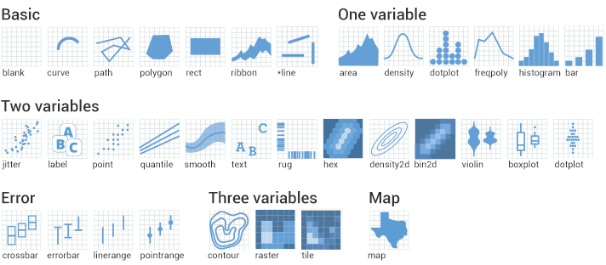
geoms
ggplot(data = <DATA>, mapping = aes(<MAPPINGS>)+ geom_***()

Slide 14
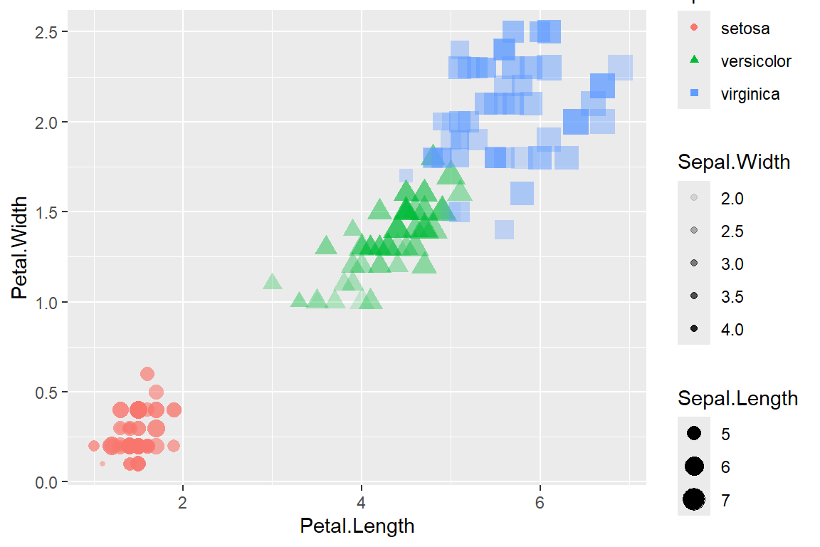
aesthetics
Aesthetics define how data variables are mapped to visual properties in your plot
They control things like: > x and y position > color (or fill for bars and areas) > size > shape > alpha (transparency) > linetype

Slide 15
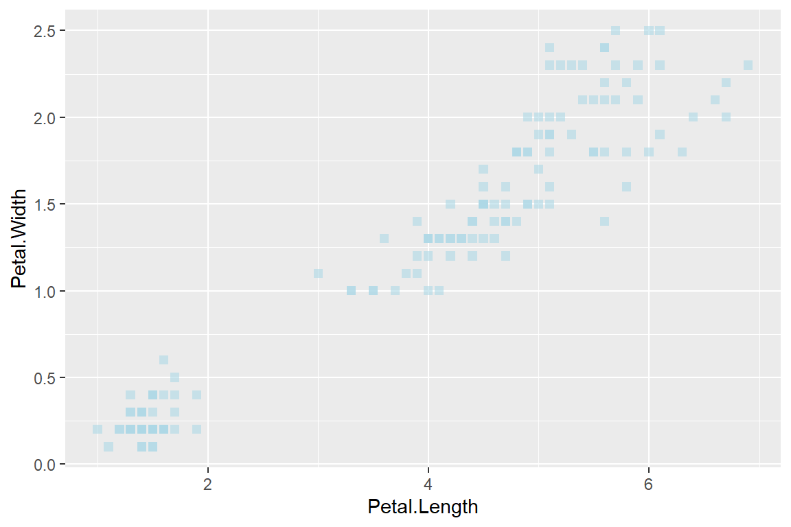
aesthetics
*Mapped to specific variables*
ggplot(data = iris) + geom_point(mapping = aes(x = Petal.Length, y = Petal.Width, color = Species, size = Sepal.Length, alpha = Sepal.Width, shape = Species))
ggplot(data = iris) + geom_point(mapping = aes(x = Petal.Length, y = Petal.Width), color = "lightblue", size = 2, alpha = 0.6, shape = 15)
Variables to map to
Aesthetic properties

Slide 16
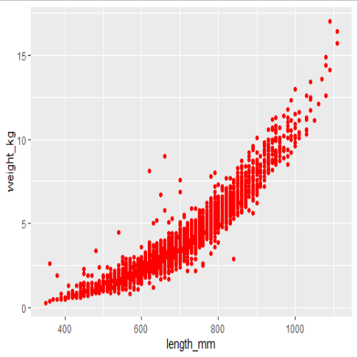
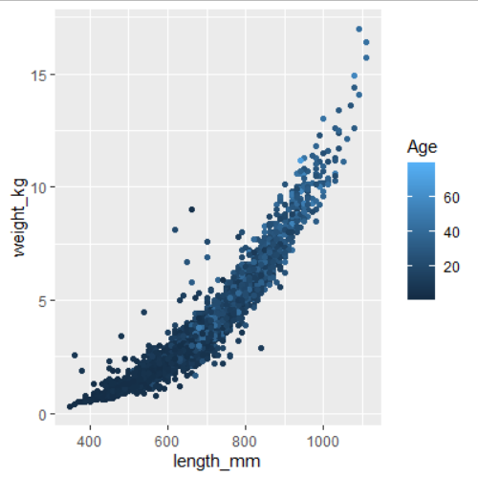
aes()
It can be tricky to wrap your head around the aes() function
Make sure to keep the aes() inside the ggplot()
Anything that is static goes OUTSIDE the aes(), in geom
Anything dynamic (changes according to a variable) goes INSIDE the aes()
Static: color does not change
Dynamic: color changes by variable
ggplot(sablefish, aes(x=length_mm, y = weight_kg)) +
geom_point(color = "red")
ggplot(sablefish, aes(x=length_mm, y = weight_kg, color = Age)) +
geom_point()

Slide 17
Your Turn 2
Navigate to ## Your Turn 2 in the ggplot.Rmd
Experiment with different geom_ types and aesthetics
💡try mapping color, size, alpha to continuous (body_mass_g, flipper_length_mm, bill length / depth) and discrete variables (sex, species, island) 📑 reference the cheat sheet for more ideas 🤚feel free to ask any questions

Slide 18
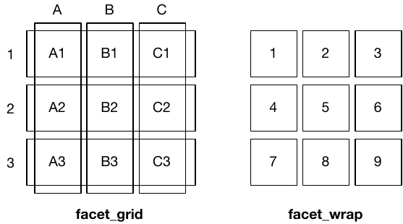
facets
Smaller plots for subsets of the data
- wraps 1d ribbon of panels into 2d
- 2d grid of panels
- Rows ~ Columns
- Two discrete variables
> facet_wrap(~Variable1)
> facet_grid(Variable1 ~ Variable2)

Slide 19
Your Turn 3
Navigate to Your Turn 3 in the ggplot.Rmd
Experiment with different facet options. Try different combinations of geoms with facets by island, species, sex, or year. 💡Bonus! You can also use the labs() function to modify axis, legend, and title labels.
> labs(title = "Title", x = "X-axis label", y = "Y-axis label", color = "Change the legend title for color", and many more options)

Slide 20
scales
Control the mapping from data to aesthetics (color, size, axis limits, etc)
> scale_<aesthetic>_<type>()
<aesthetic>
is the visual property you’re controlling (x, y, color, fill, size, shape, etc)
<type>
Is the kind of scale used (continuous, discrete, manual, brewer, data, identity, etc)
<aesthetic> | scale example | What it controls?
x,y | scale_x_continuous(), scale_y_log10() | Axis limits, transformations, breaks, labels
color | scale_color_manual(), scale_color_brewer() | Map values to colors. Manual, discrete, continuous, or prebuilt palletes (brewer)
fill | scale_fill_viridis_d() | Fill in bars, boxes, violins, etc
size | scale_size_continuous() | Size of points, lines, etc
shape | scale_shape_manual() | Different point shapes for categories
alpha | scale_alpha_manual() | Transparency leve
linetype | scale_linetype_manual() | Dashed, dotted, solid linetypes
label | scale_x_discrete(labels = …) | Customize axis or legend text

Slide 21
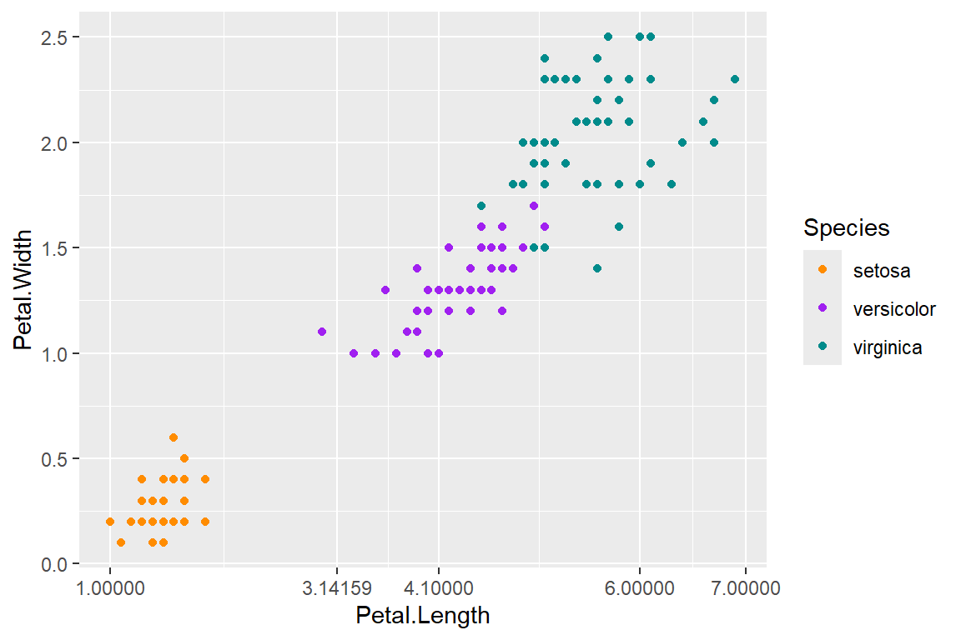
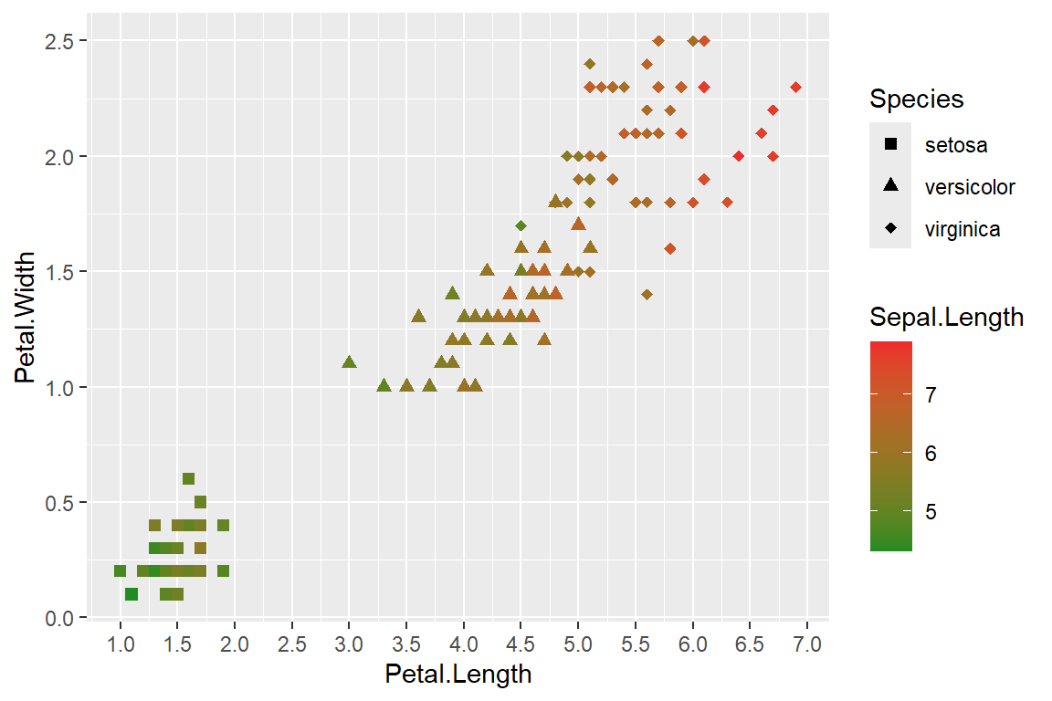
> scale_<aesthetic>_<type>()
> ggplot(iris, aes(x = Petal.Length, y = Petal.Width, shape = Species, color = Sepal.Length)) + geom_point(size = 2) + scale_shape_manual(values = c(15, 17, 18)) +#Square, triangle, diamond scale_color_continuous(low = "forestgreen",high = "firebrick2") + #Continuous gradient scale_x_continuous(breaks = seq(0, 10,0.5)) #X-axis scaling
>ggplot(iris, aes(x = Petal.Length, y = Petal.Width, color = Species)) + geom_point() + scale_color_manual(values = c("darkorange", "purple", "cyan4")) + # Choosing specific colors scale_x_continuous(breaks = c(0,1,3.14159,4.1,6,7)) #Custom X tick marks

Slide 22
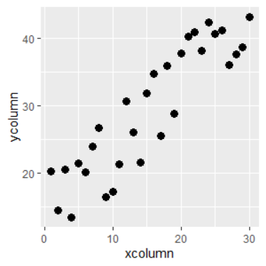
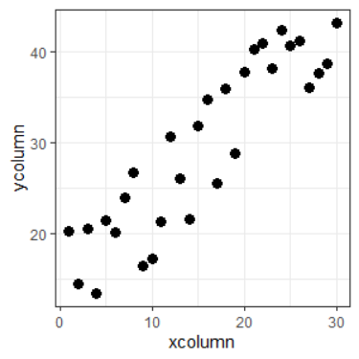
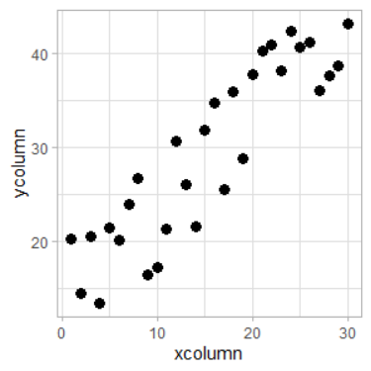
theme
Control the non-data elements like background, grid lines, fonts, legend positions. There are several built in themes
+ theme_bw()
+ theme_minimal()
+ theme_light()
default
theme_bw()
theme_light()
Notes:
Many of these change the background and line / border colors etc. theme_minimal is what I use the most for simplicity. Generally have to google each aspect I am interested in changing. “How do I change ggplot title font and size”

Slide 23
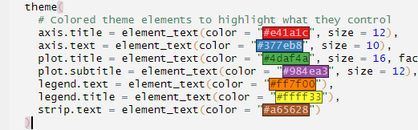
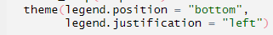
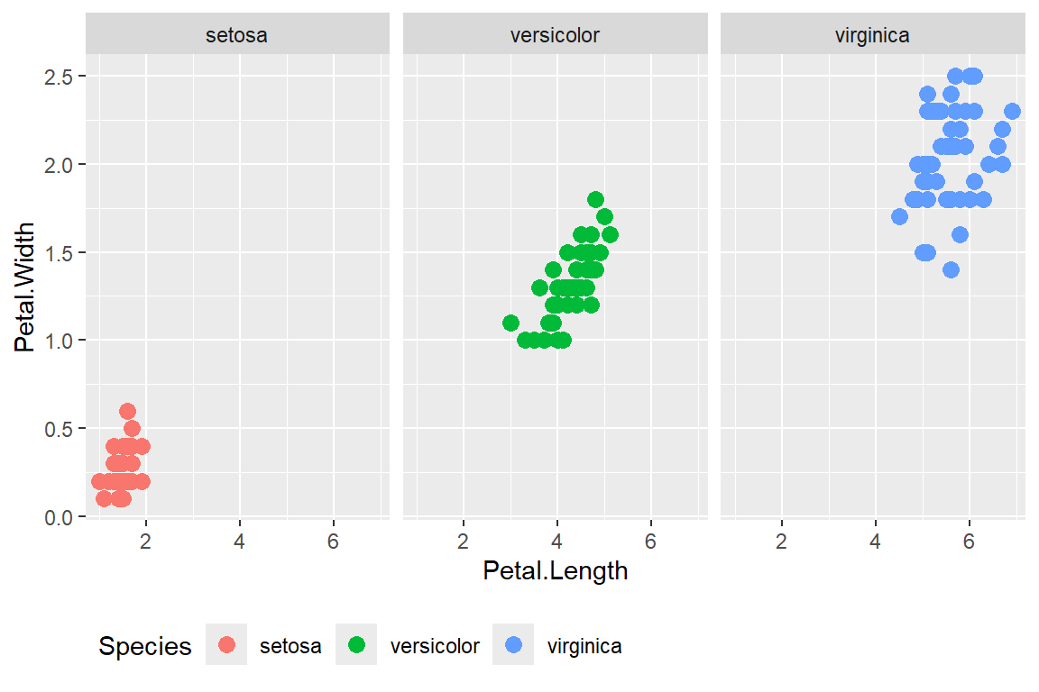
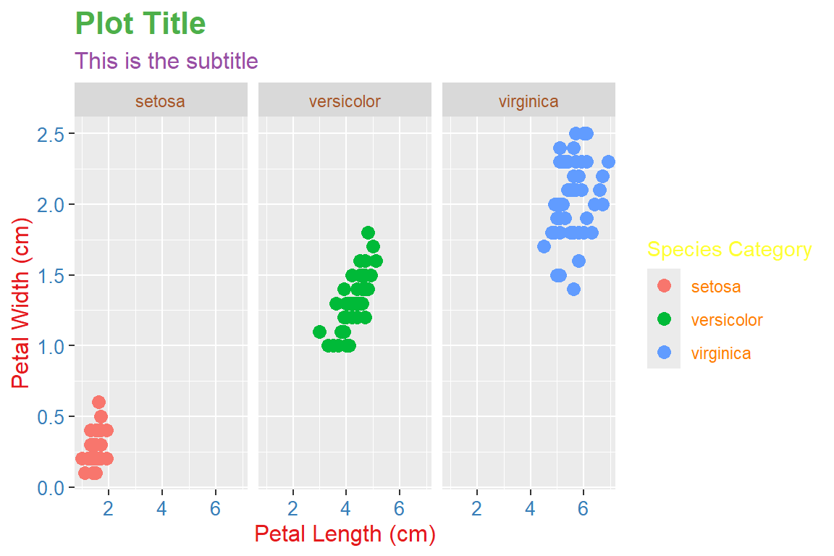
theme
Notes:
Changing legend position is an easy one to remember. You can change every aspect of the texts, colors, fonts, size, position, etc.

Slide 24
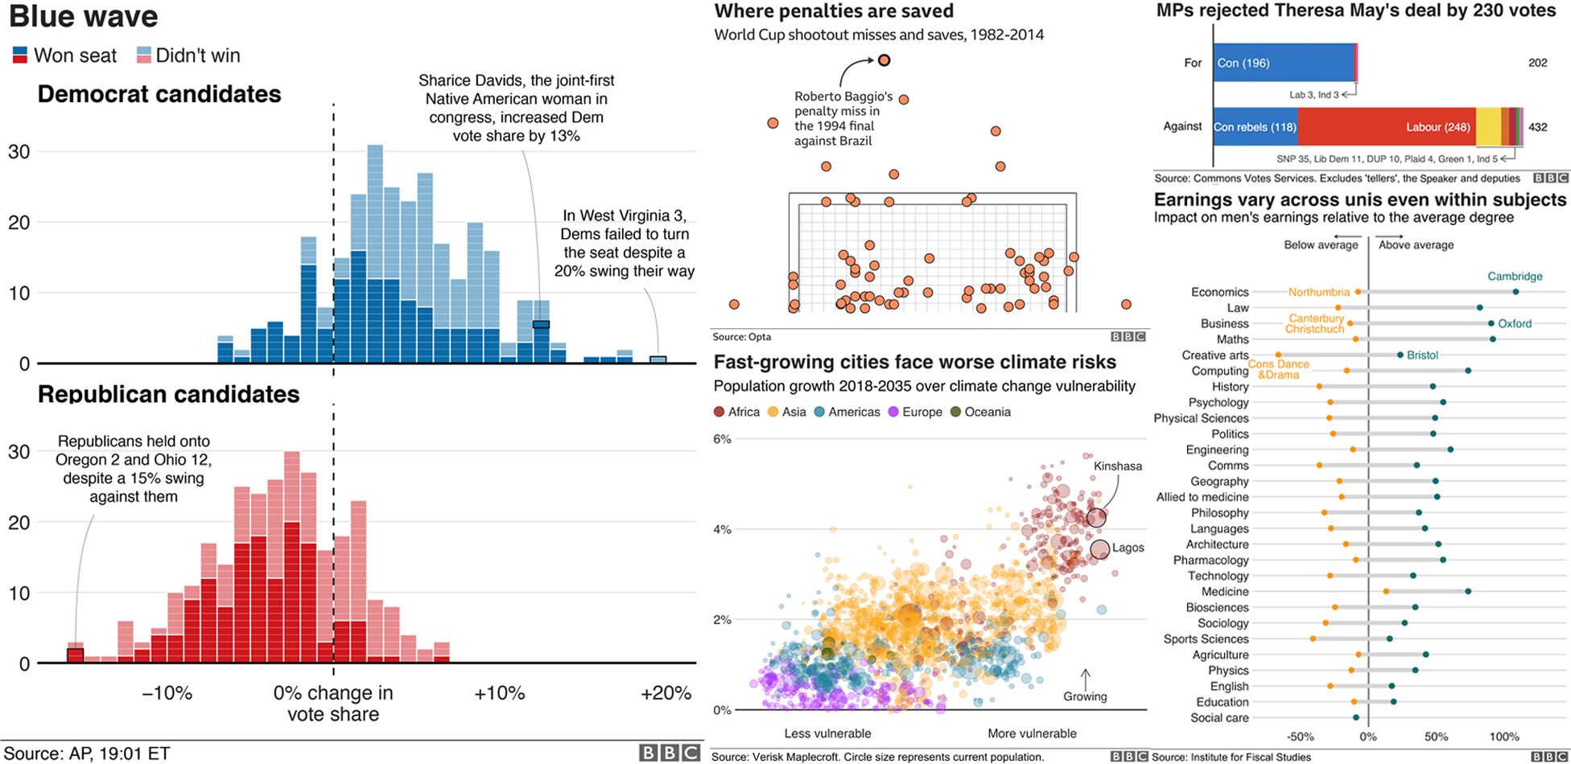
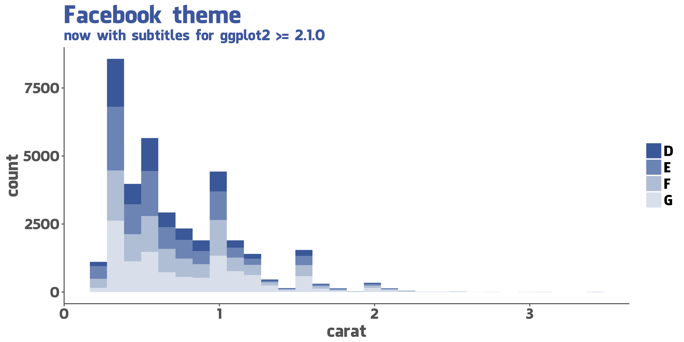
theme
Github: GGtech
BBC Visual and Data Journalism cookbook for R graphics
Notes:
Examples of publication quality themes / graphics. BBCs inhouse

Slide 25
coordinates
Coordinates change how the plot is drawn – not the underlying data
+ coord_flip() – to rotate axes (useful for horizontal bar charts) + coord_polar() – to transform cartesian plots into circular ones

Slide 26
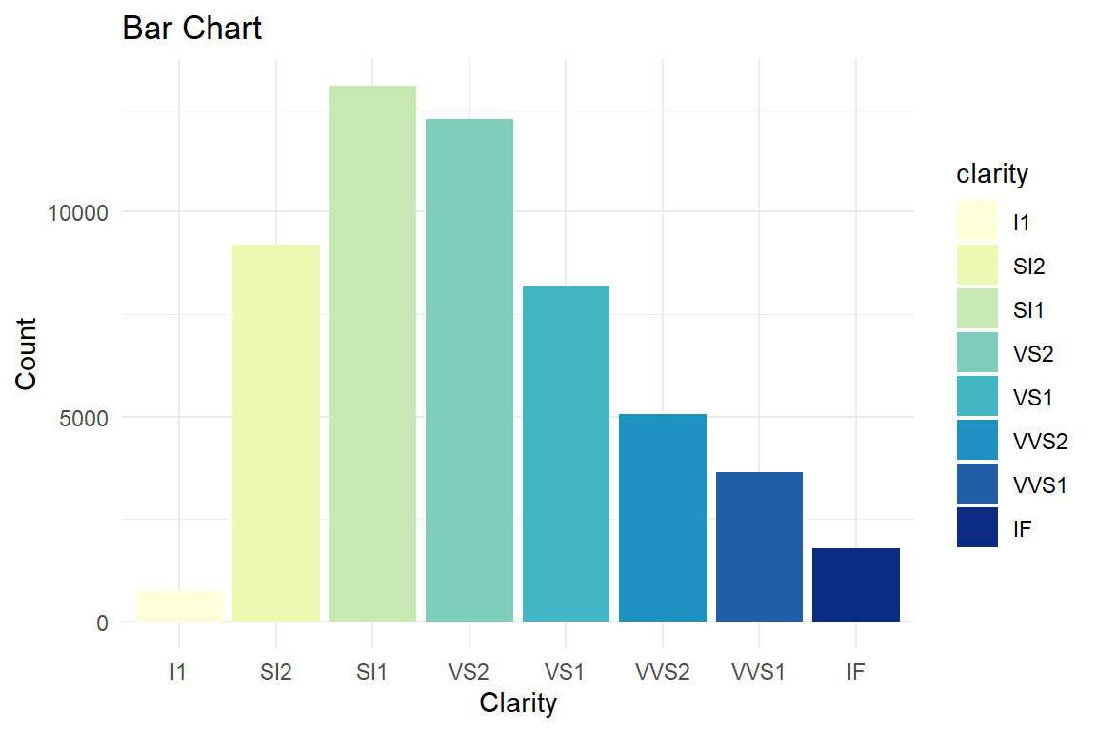
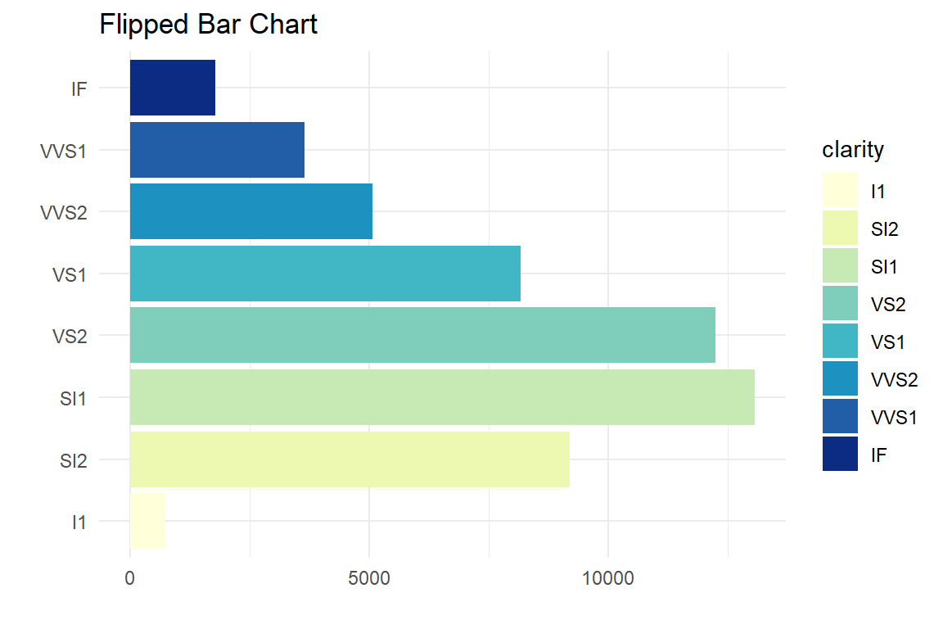
coordinates
>ggplot(diamonds, aes(x = clarity, fill = clarity)) + geom_bar() + scale_fill_brewer(palette = "YlGnBu") + theme_minimal() + labs(title = "Bar Chart", x = "Clarity", y = "Count“)
+ coord_flip()

Slide 27
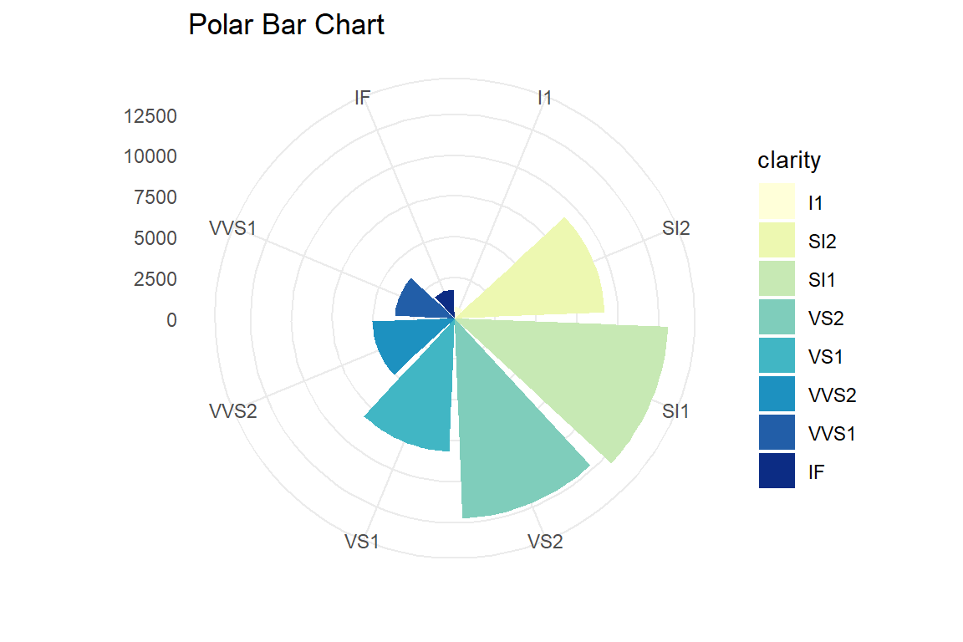
coordinates
>ggplot(diamonds, aes(x = clarity, fill = clarity)) + geom_bar() + scale_fill_brewer(palette = "YlGnBu") + theme_minimal() + labs(title = "Bar Chart", x = "Clarity", y = "Count“)
+ coord_polar()

Slide 28
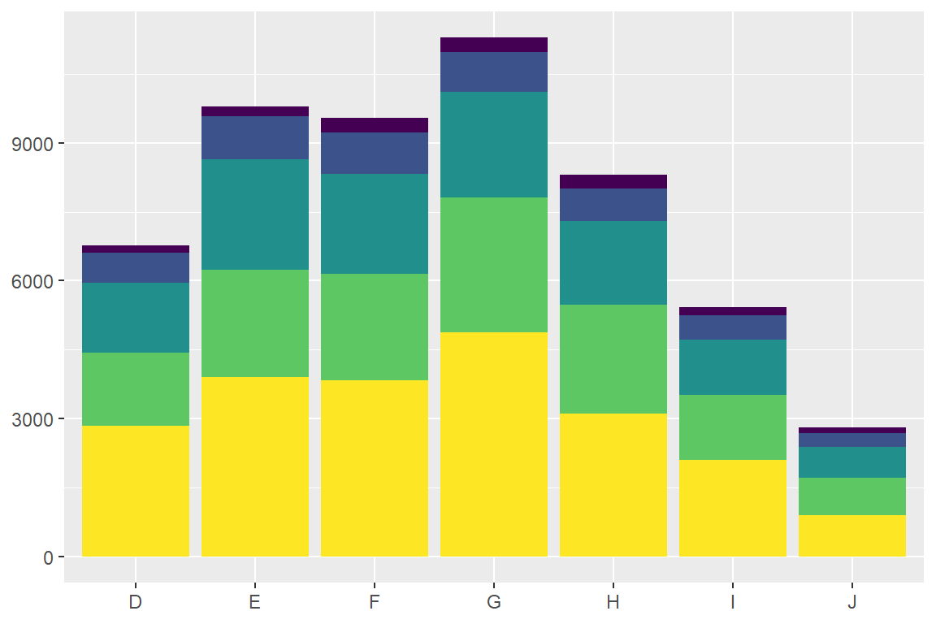
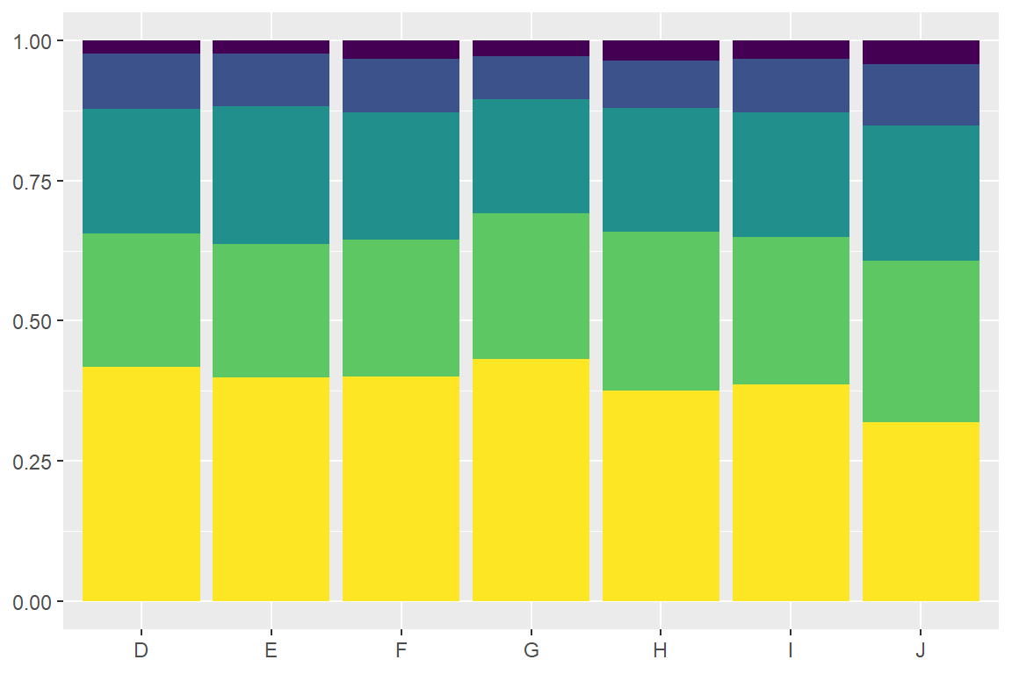
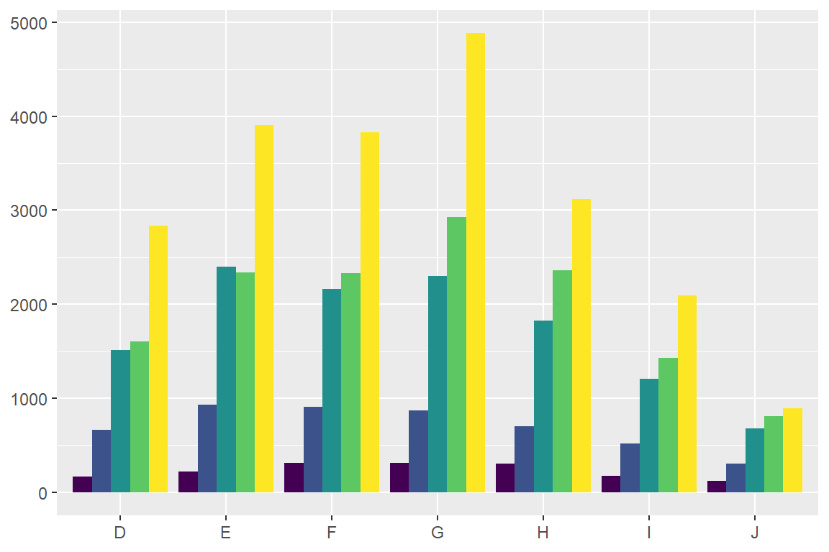
position
> position_stack(): stack overlapping bars (or areas) on top of each other.
> position_fill(): stack overlapping bars, scaling so the top is always at 1.
> position_dodge(): place overlapping bars (or boxplots) side-by-side.
> ggplot(diamonds, aes(x = color, fill = cut)) +
geom_bar(postion = "stack")
geom_bar(position = "fill")
geom_bar(position = "dodge")

Slide 29


saving!
If you want to save your ggplot, save to environment and use ggsave()
plotname <- ggplot(dfname, aes(x = xcol, y=ycol)) +
geom_point()
ggsave(plot = plotname,
filename = "output/filesavename.png", dpi = 300,
width = 6,
height = 4,
units = "in")
Object name
Dots per inch (≥300)
Set width, height and
what units you’re using

Slide 30
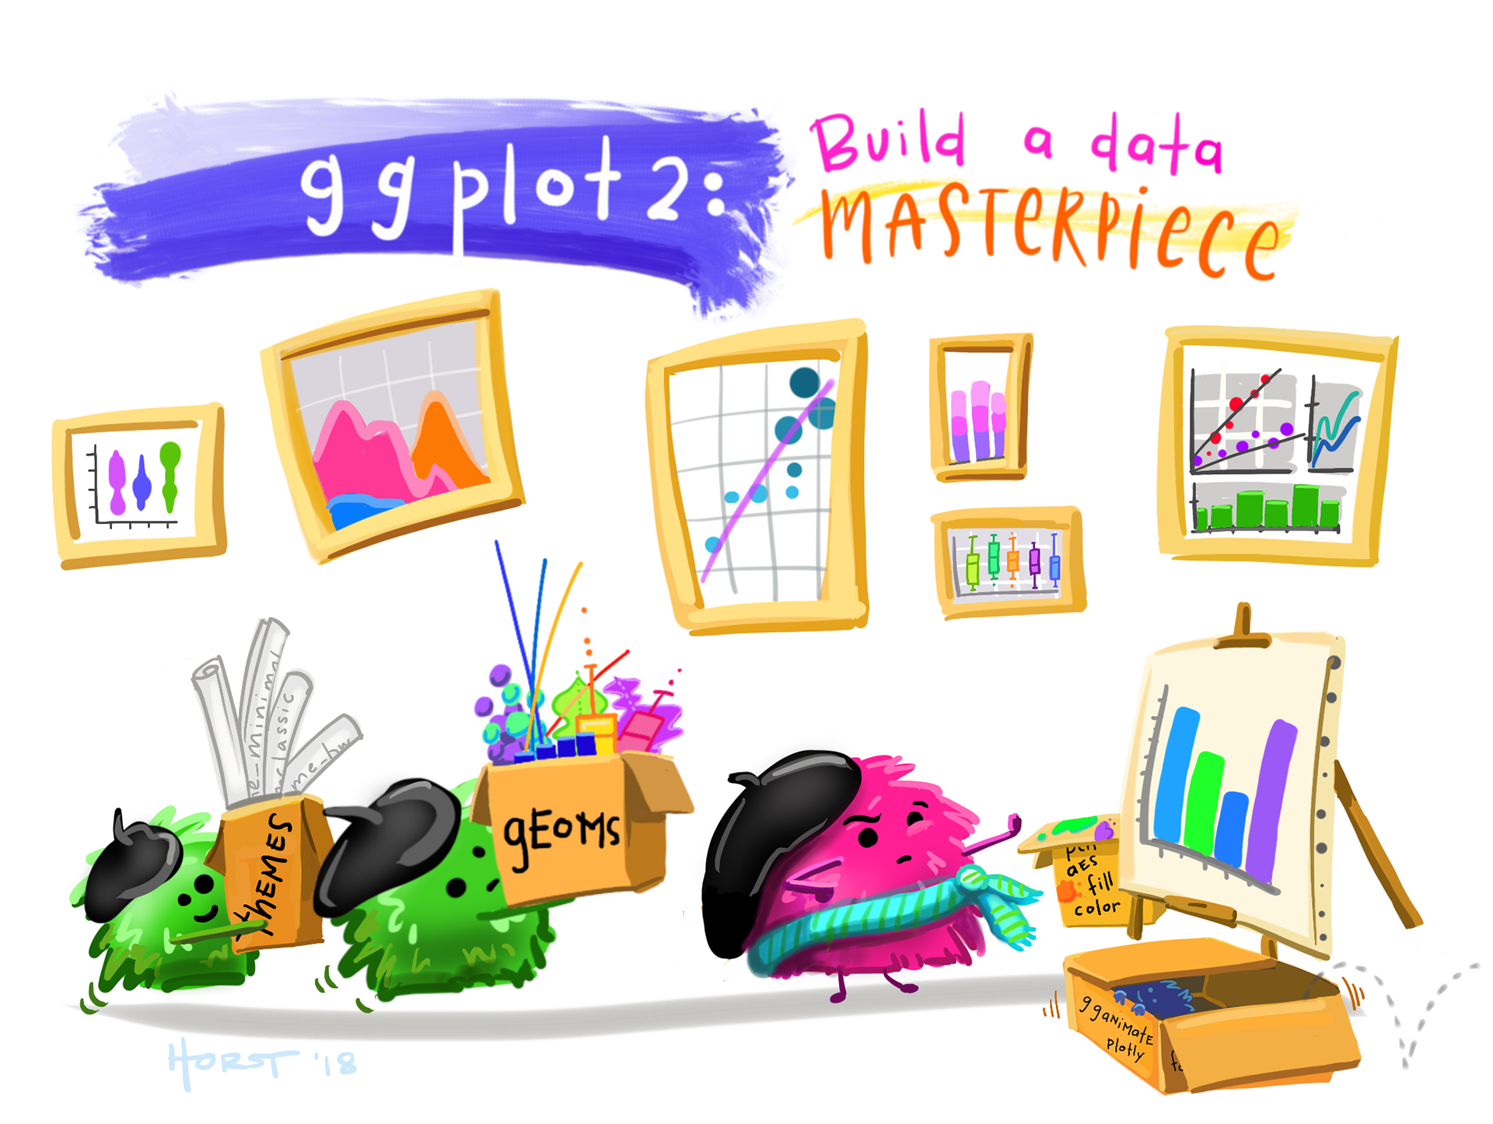
🧠 final challenge
Navigate to the final challenge section in the ggplot.Rmd
Put your skills into action and create your own ggplot to share.
Artwork by @allison_horst

